Slide 1
CS 4408
Lecture 9

Slide 2
XSLT instruction elements
We have seen that a template can contain non-XSLT text, canned text that it inserts into the result tree
A template can also contain XSLT instruction elements
  when the template is instantiated, each instruction is executed and the text fragment that it creates is placed in the result tree
Instructions can select and process descendant source elements.
Processing a descendant element creates a result tree fragment by finding the applicable template rule and instantiating its template.

Slide 3
An XSLT instruction element
The instruction
  <xsl:apply-templates/>
  processes the content of the current element
  including any descendents of the current element
It processes the descendent elements by applying the template rules that match those descendent elements

Slide 4
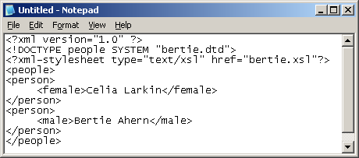
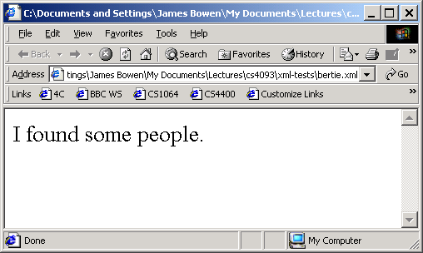
The xsl:apply-templates instruction
The stylesheet below contains an example application of this instruction:
<?xml version="1.0"?>
<xsl:stylesheet xmlns:xsl="http://www.w3.org/1999/XSL/Transform“ version="1.0">
<xsl:template match="/“ > <xsl:apply-templates /> </xsl:template>
<xsl:template match="people“ > <p>I found some people.</p> </xsl:template>
</xsl:stylesheet>

Slide 5
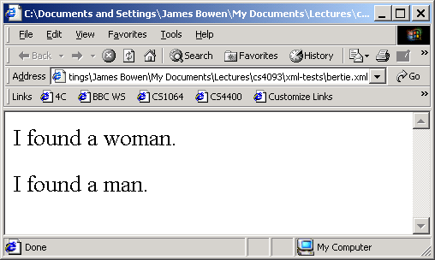
xsl:apply-templates instruction (contd.)
The stylesheet below contains another application of this instruction
Notice that, when applying templates to the content of the root element, it finds the male and female elements
<?xml version="1.0"?>
<xsl:stylesheet xmlns:xsl="http://www.w3.org/1999/XSL/Transform“ version="1.0">
<xsl:template match="/“ ><body> <xsl:apply-templates /> </body> </xsl:template>
<xsl:template match=“male“ > <p>I found a man.</p> </xsl:template>
<xsl:template match=“female“ > <p>I found a woman.</p> </xsl:template>
</xsl:stylesheet>

Slide 6
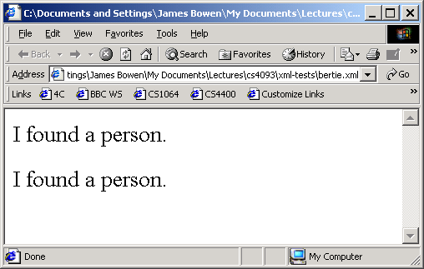
xsl:apply-templates instruction (contd.)
In this third example, the person elements are found
  but their children (the male and female elements) are not processed, even thought there are templates for them
  this is because processing the people element does not involve processing its descendant elements
<?xml version="1.0"?>
<xsl:stylesheet xmlns:xsl="http://www.w3.org/1999/XSL/Transform“ version="1.0">
<xsl:template match="/“ > <body> <xsl:apply-templates /> </body> </xsl:template>
<xsl:template match=“person“ > <p>I found a person.</p> </xsl:template>
<xsl:template match=“male“ > <p>I found a man.</p> </xsl:template>
<xsl:template match=“female“ > <p>I found a woman.</p> </xsl:template>
</xsl:stylesheet>

Slide 7
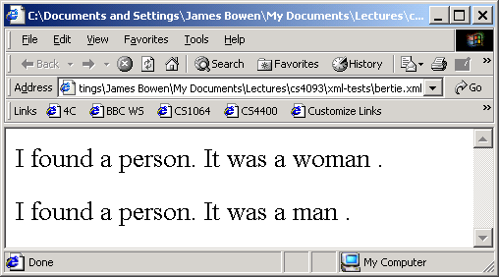
xsl:apply-templates instruction (contd.)
In this example, the person elements are found
  their children (the male and female elements) are also processed
  because the template for person elements uses the xsl:apply-templates instruction to process the children of person elements
<?xml version="1.0"?>
<xsl:stylesheet xmlns:xsl="http://www.w3.org/1999/XSL/Transform“ version="1.0">
<xsl:template match="/“ ><body> <xsl:apply-templates /></body> </xsl:template>
<xsl:template match=“person“ >
<p>I found a person. It was <xsl:apply-templates/> .</p> </xsl:template>
<xsl:template match=“male“ >a man</xsl:template>
<xsl:template match=“female“ >a woman</xsl:template>
</xsl:stylesheet>

Slide 8
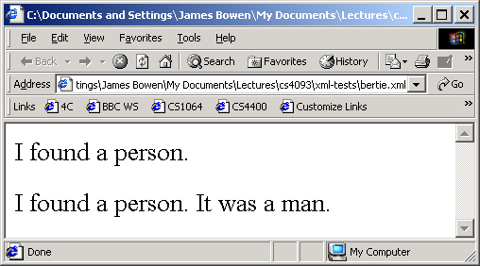
the select attribute
The xsl:apply-templates instruction has a select attribute which can be used to limit its application
  Below, only male children of person elements are processed, even though there is a template for female elements
<?xml version="1.0"?>
<xsl:stylesheet xmlns:xsl="http://www.w3.org/1999/XSL/Transform“ version="1.0">
<xsl:template match="/“ > <body> <xsl:apply-templates /> </body> </xsl:template>
<xsl:template match=“person“ > <p>I found a person.
<xsl:apply-templates select=“male”/> </p> </xsl:template>
<xsl:template match=“male“ >It was a man.</xsl:template>
<xsl:template match=“female“ >It was a woman.</xsl:template>
</xsl:stylesheet>

Slide 9
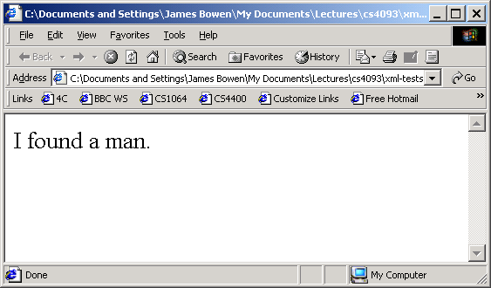
the select attribute (contd.)
The select attribute can have Xpath expressions as values
  Below, only male descendents of people elements are processed, even though there is a template for female elements
<?xml version="1.0"?>
<xsl:stylesheet xmlns:xsl="http://www.w3.org/1999/XSL/Transform“ version="1.0">
<xsl:template match="/">
<body> <xsl:apply-templates select="people//male” /> </body> </xsl:template>
<xsl:template match="male"><p>I found a man.</p></xsl:template>
<xsl:template match="female"><p>I found a woman.</p></xsl:template>
</xsl:stylesheet>

Slide 10
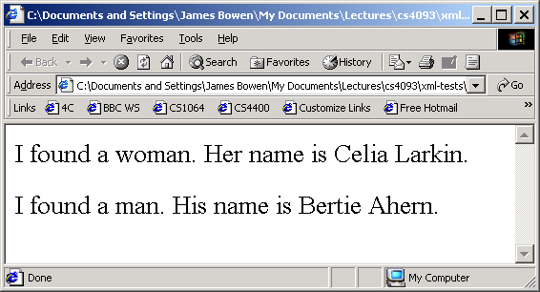
the xsl:value-of instruction
This can be used to generate result text by extracting data from the source tree.
  Its required select attribute species the data to be extracted
  In the values of the select attribute, the dot character (.) means “the context node”
    For now, you can think of this as the "current node" -- but, sometimes, there is a difference -- as we will see later
<?xml version="1.0"?>
<xsl:stylesheet xmlns:xsl="http://www.w3.org/1999/XSL/Transform“ version="1.0">
<xsl:template match="/"><body><xsl:apply-templates/></body> </xsl:template>
<xsl:template match="female">
<p>I found a woman. Her name is <xsl:value-of select="."/>.</p></xsl:template>
<xsl:template match="male">
<p>I found a man. His name is <xsl:value-of select="."/>.</p></xsl:template>
</xsl:stylesheet>

Slide 11
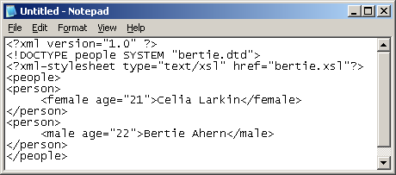
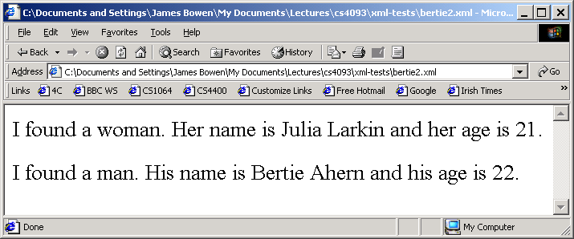
the xsl:value-of instruction (contd.)
This can also extract attribute values from the source tree
  In its value patterns, the character @ prefixes an attribute name
<?xml version="1.0"?>
<xsl:stylesheet xmlns:xsl="http://www.w3.org/1999/XSL/Transform“ version="1.0">
<xsl:template match="/"><body><xsl:apply-templates/></body> </xsl:template>
<xsl:template match="female">
<p>I found a woman. Her name is <xsl:value-of select="."/> and her
age is <xsl:value-of select="@age"/>.</p></xsl:template>
<xsl:template match="male">
<p>I found a man. His name is <xsl:value-of select="."/> and his
age is <xsl:value-of select="@age"/>.</p> </xsl:template>
</xsl:stylesheet>

